Slide 1
User Interaction
By Brian Stoepker

Slide 2
What is user interaction?
A situation in which the effect of one explanatory variable on the outcome is affected by the value of a second explanatory variable.

Slide 3
What is user interaction?
A situation in which the effect of one explanatory variable on the outcome is affected by the value of a second explanatory variable.
What???

Slide 4
What is user interaction?
A situation in which the effect of one explanatory variable on the outcome is affected by the value of a second explanatory variable.
What?
Since we’re focusing on gaming we can be more specific…
The player’s ability to affect what happens in the game
How immerged into the game the player feels

Slide 5
Why Focus on Player Interaction?
Players want to feel immerged in the game!
Many players want to be able to affect their environment as much as possible
More variety of interaction means more gameplay variety
so you can do MORE STUFF

Slide 6
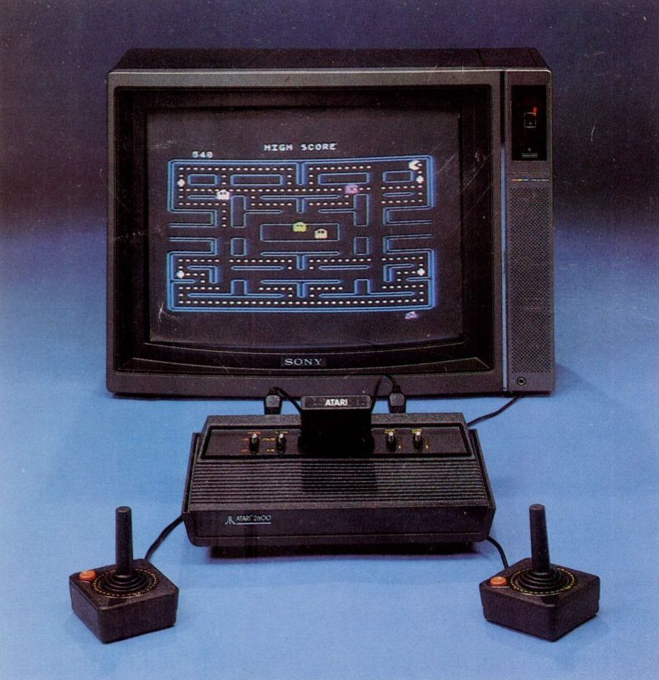
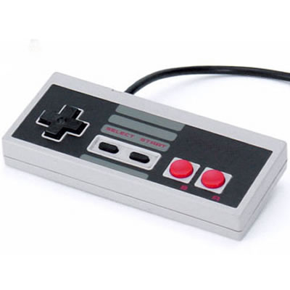
Basic Interaction
In the beginning…
4-directional pad or joystick
Buttons!
Character movement

Slide 7
Giving the players more options
The next step was to give players the ability to do more than move and occasionally jump or even punch…

Slide 8
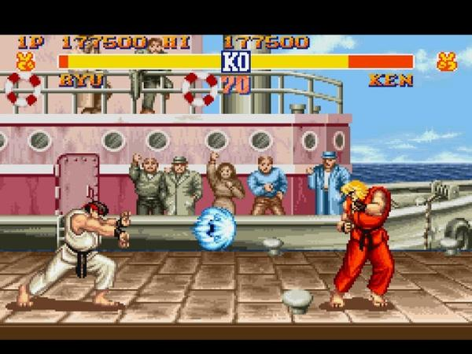
Giving the players more options
The next step was to give players the ability to do more than move and occasionally jump or even punch…
Attack combos
Multiple weapons
Street Fighter II for SNES

Slide 9
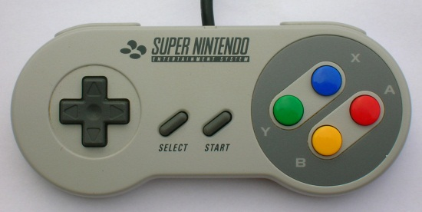
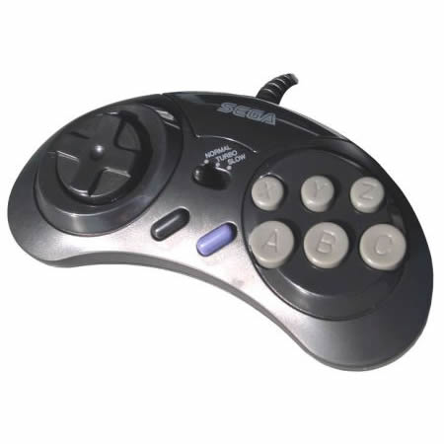
Giving the players more options
The next step was to give players the ability to do more than move and occasionally jump or even punch…
Attack combos
Multiple weapons
More buttons!
Street Fighter II for SNES

Slide 10
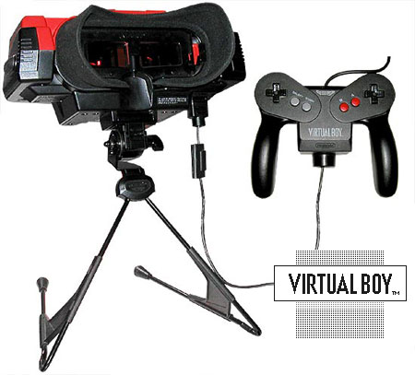
Advancing immersion
The first big step: 3D
Nintendo’s approach: Virtual Boy
Released in 1995

Slide 11
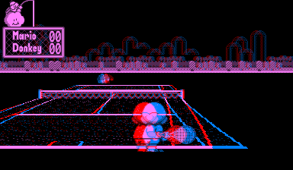
Advancing immersion
The first big step: 3D
Nintendo’s approach: Virtual Boy
Released in 1995
Epic failure

Slide 12
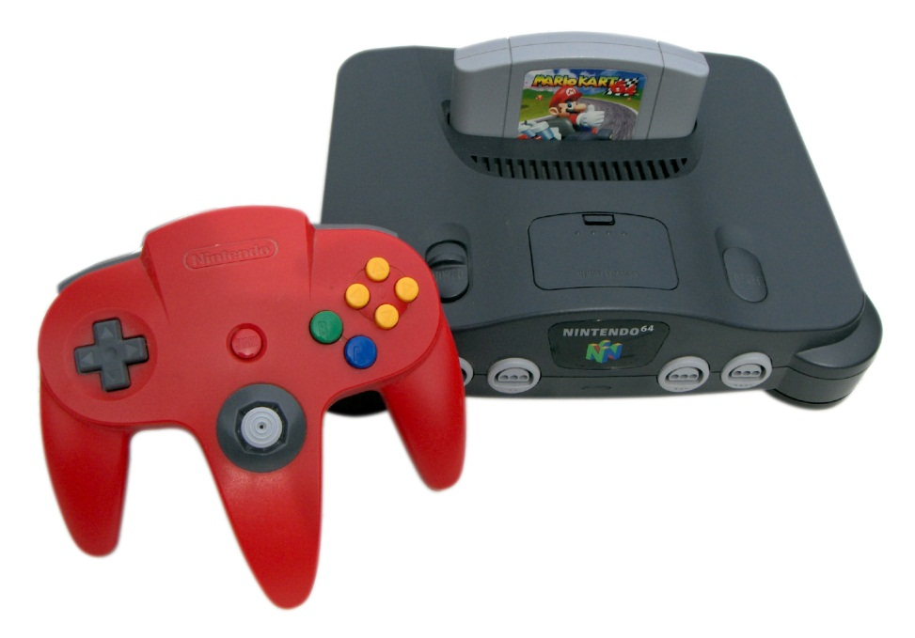
Advancing immersion
The first big step: 3D
Nintendo’s better approach: Nintendo 64
Released in 1996
Well designed controller
Except that you need 3 hands

Slide 13
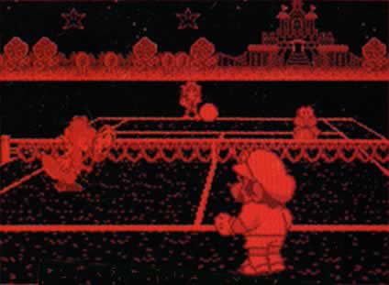
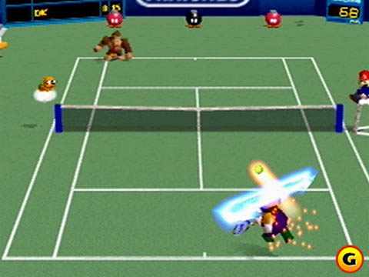
The Difference
Mario Tennis (N64)
Mario Tennis (Virtual Boy)

Slide 14
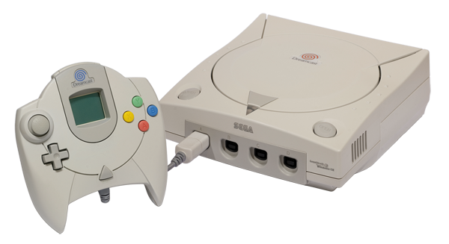
Advancing immersion
Sega’s approach: Dreamcast
Basically the same idea as N64, only much later
Released in 1999
Uses discs instead of cartridges
First console to have online play (kind of)

Slide 15
Context Sensitive controls
Allow a player to perform actions that can’t be done in normal circumstances
Conker’s Bad Fur Day (N64)

Slide 16
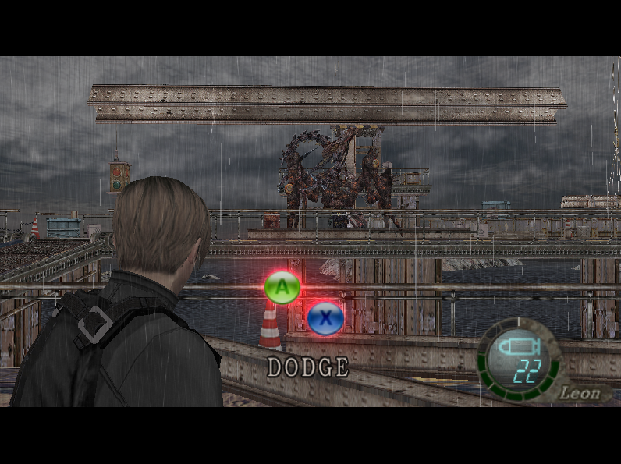
Context Sensitive controls
God of War (PS2)
Resident Evil 4 (Gamecube/PS2)

Slide 17
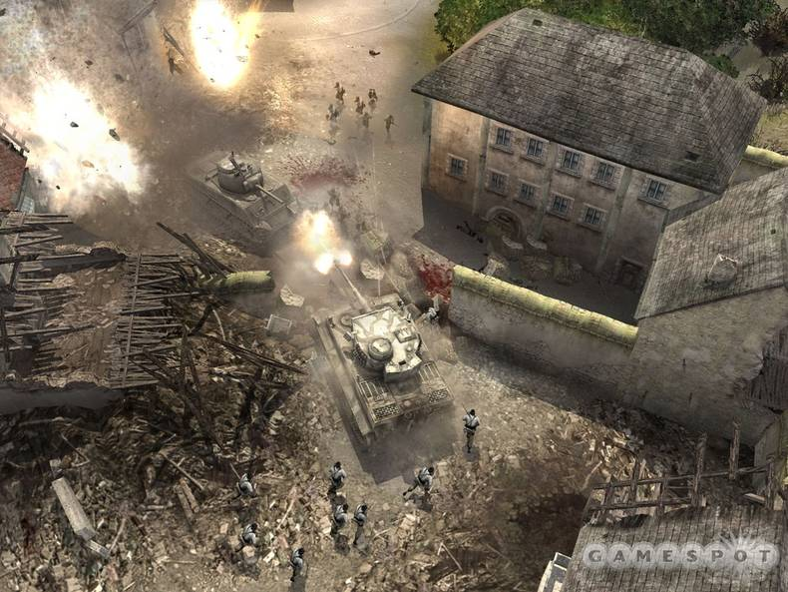
“fully Destructible”
You can basically blow everything up
Simpsons Road Rage
Recently:
Red Faction: Guerrilla
Battlefield: Bad Company
Miner Wars (MMO in development)
Company of Heroes (shown above)

Slide 18
A New Generation
While Sony and Microsoft mostly just beefed up their hardware, Nintendo has taken the approach of increased interactivity to capture the casual gaming market…
…with great success

Slide 19
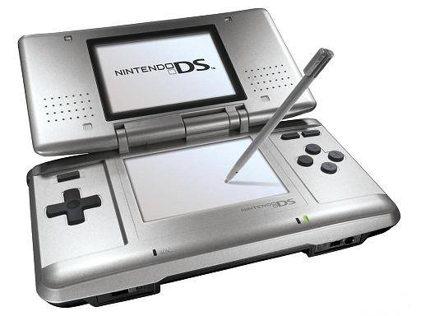
Nintendo DS
Two screens allow a HUD or mini-map to be shown without it getting in the way
Touch screen and microphone to make players feel more immerged
Released in November 2004; 126 million sold

Slide 20
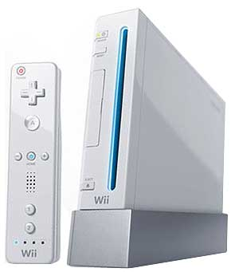
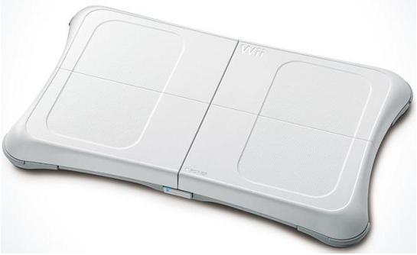
Nintendo wii
Completely new controller design
Attachments allow for different controllers to be developed
Gyroscope and infrared camera detect movement
Released in November 2006, 68 million sold

Slide 21
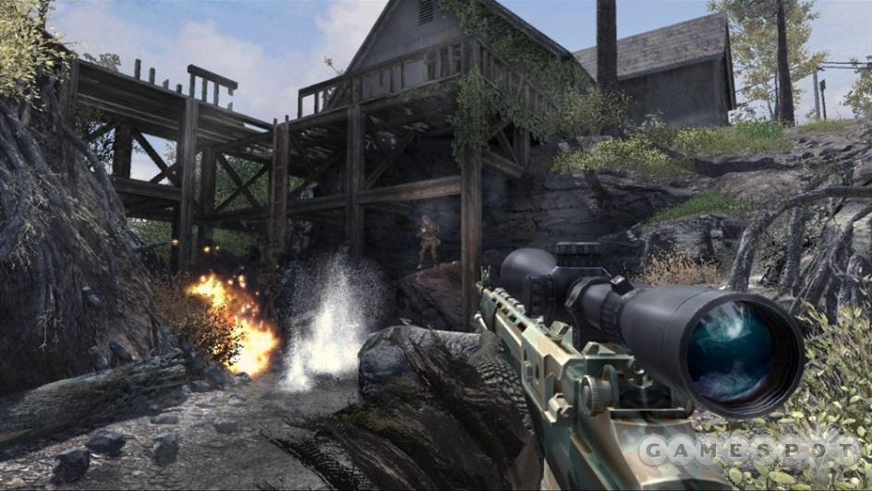
XBOX 360
Online gameplay rivals PC
Headset and controller used instead of keyboard and mouse to make players feel like they’re in the heat of the action
Most successful with first person shooters
Released in November 2005; 39 million sold
Call of Duty:
Modern Warfare 2

Slide 22
Music-Based games
Provide the player with an instrument, microphone, dance pad, etc.
Players get into the music and in turn get into the game
Dance Dance Revolution
Guitar Hero
Rock Band
StepMania
American Idol (or other karaoke games)

Slide 23
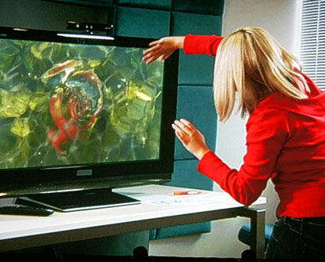
The future of Interactivity
Project Natal: Meet Milo
More human-like NPCs
No HUD
Camera used to accurately track player movement

Slide 24
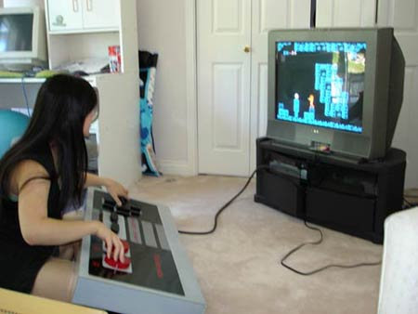
Bibliography
http://rctbank.ucsf.edu/BaT/html-files/glossary.html
http://images.google.com/
http://en.wikipedia.org

